Slide 1
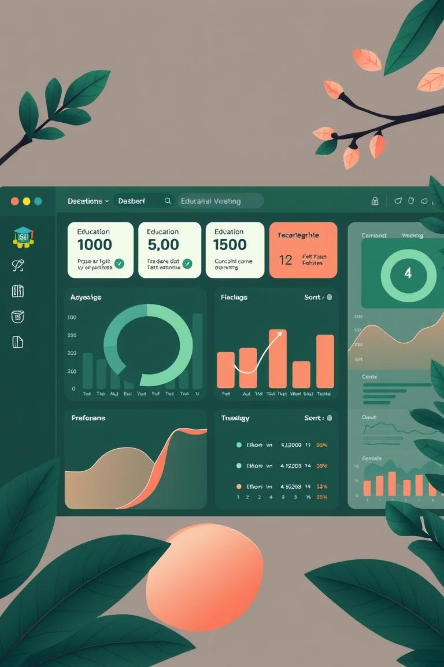
Online Course Progress Tracker Overview
Our Online Course Progress Tracker is designed to provide clear, actionable insights into learner engagement and performance. By visualising progress, we can foster motivation, enhance course content, and boost overall completion rates.

Slide 2
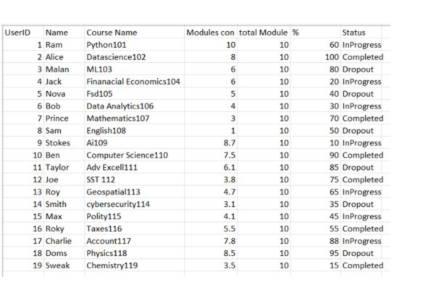
Detailed User Progress Table
The user progress table offers a granular view of each learner's journey, making it simple to pinpoint individual needs and successes. It's a dynamic tool for effective monitoring.
15

Slide 3
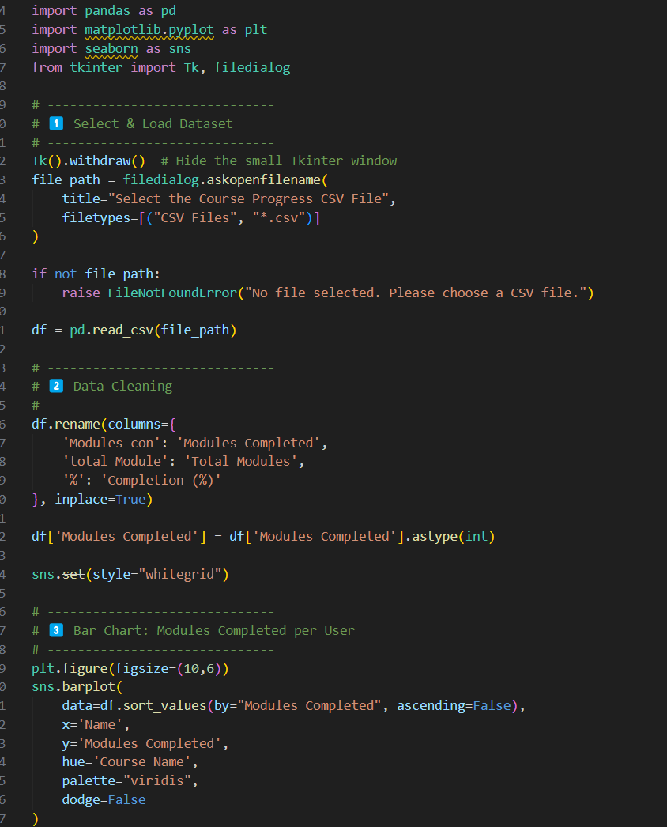
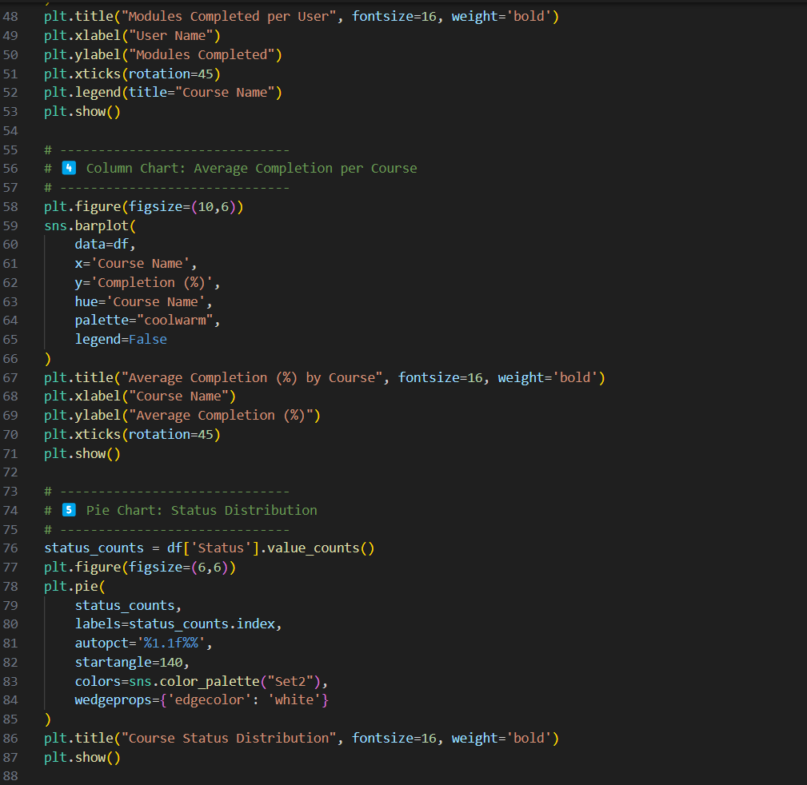
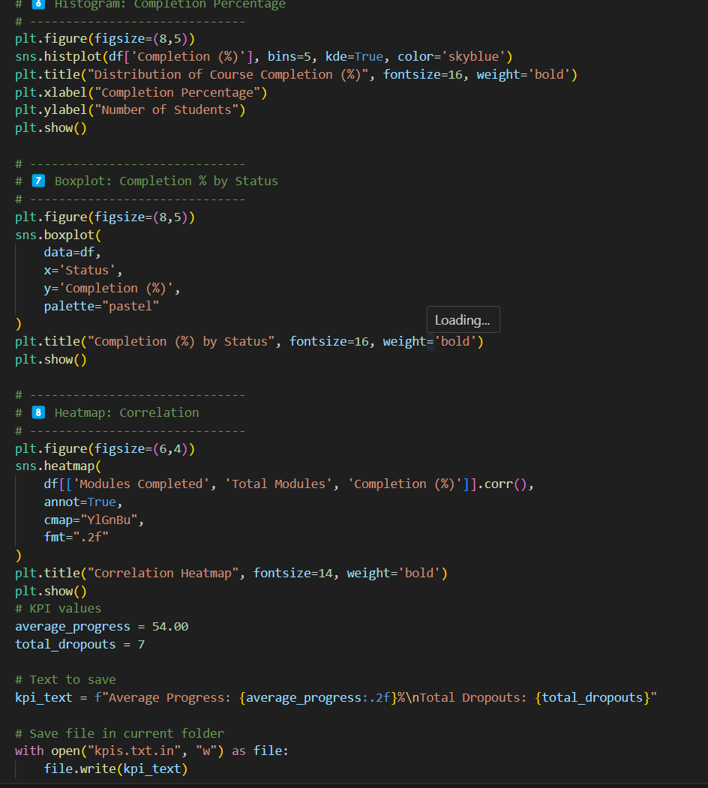
The Fix: Automated Cleaning with Python
Leveraging Python for Efficiency:
Developed a robust Python script.
Utilised the powerful Pandas library for data manipulation.
Automated the entire data cleaning and standardisation process.
r
Ensured scalability for future data growth.

Slide 4
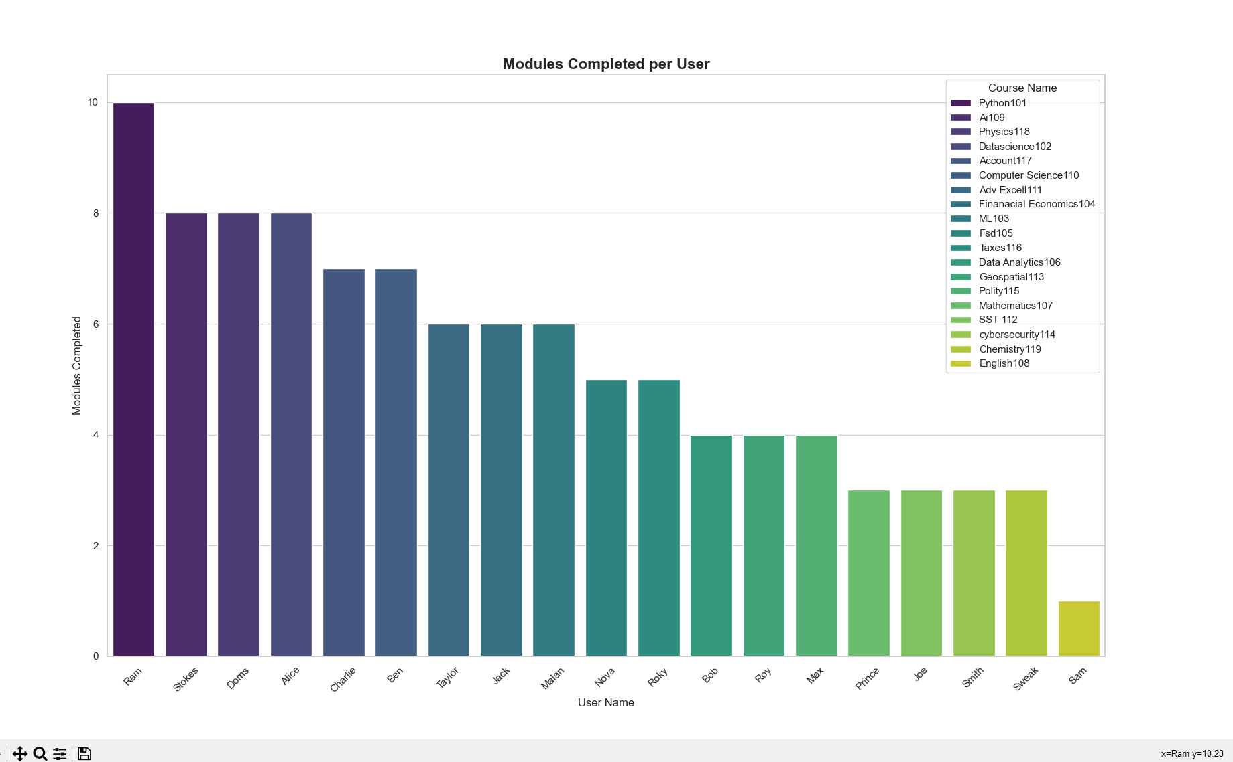
Module Completion Bar Chart
This bar chart provides a clear visual representation of completion rates for each module, allowing us to identify potential bottlenecks or areas where content might need improvement.

Slide 5
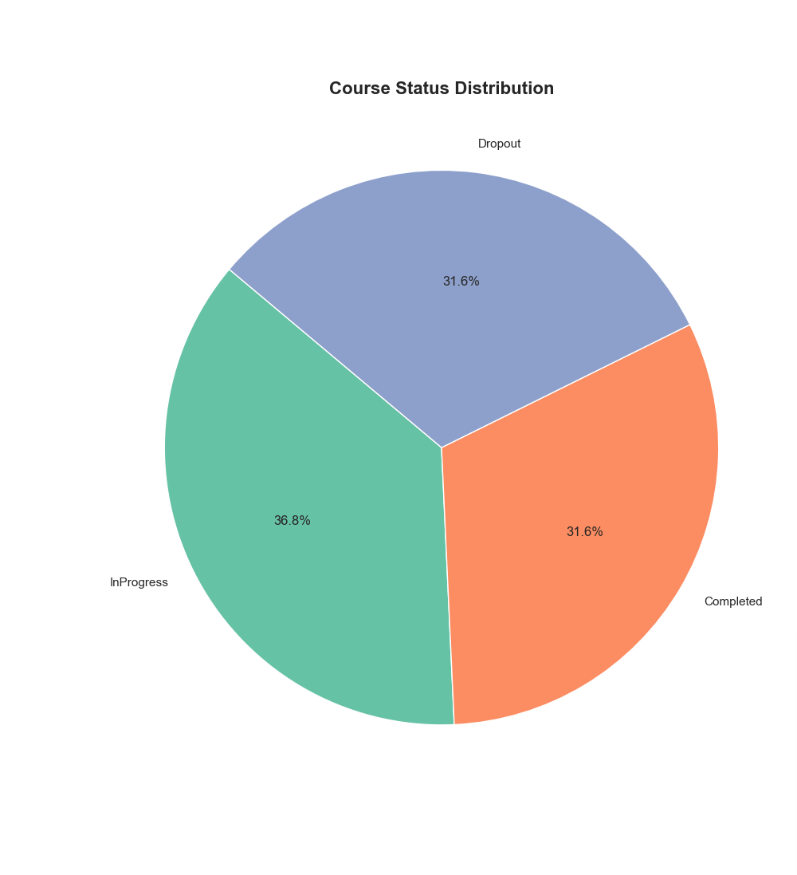
User Completion Categories: A Snapshot
The pie chart offers a quick overview of user distribution across different completion categories, highlighting engagement levels and helping to identify potential dropout risks.
0-25%
26-50%
51-75%
76-100%

Slide 6
Key Performance Indicators (KPIs)
Our tracker provides essential KPIs to gauge overall course health and learner performance, offering a comprehensive view of engagement and success.
68%
12%
40%
Avg. Progress
Dropout Rate
Completion Rate
Across all active learners
Users with minimal engagement
Learners finishing all modules

Slide 7
Data Input and Processing
The system relies on straightforward data inputs to calculate progress accurately. Each user's journey is mapped to provide real-time insights.
A simple calculation transforms raw data into meaningful progress percentages, ensuring all tracking is precise and reliable.
UserID, Name, CourseName
Progress % = (ModulesCompleted / TotalModules) × 100
ModulesCompleted, TotalModules
Robust data validation is embedded to guarantee accuracy and keep tracking up-to-date.

Slide 8



Motivation Through Visual Feedback
Visual progress indicators and gamification elements are key to boosting learner motivation and fostering continuous engagement, helping to reduce attrition rates.
Progress Bars
Achievement Animations
Regular Updates
Clear visual cues of advancement
Rewarding milestones and completion
Keeping learners informed and engaged

Slide 9



Instructor and Admin Benefits
The progress tracker empowers instructors and administrators with real-time data, enabling proactive support and informed decisions to enhance course quality and learner success.
Real-time Monitoring
Early Intervention
Data-Driven Decisions
Instant oversight of learner progress and engagement
Identify learners needing support or guidance promptly
Optimise course content and delivery based on insights

Slide 10
Summary and Next Steps
The Online Course Progress Tracker is a vital tool for fostering learner success and optimising course delivery. By providing clear visual insights, it empowers both learners and educators.
Boosts Motivation
Actionable Insights
Recommended Implementation
Visual tools encourage engagement and reduce dropouts.
Empowers instructors and admins with data for improvement.
Start with core metrics, expand with gamification elements.
Explore the Project
Github link: https://github.com/Shubhanshu007iit/online-course-progress-tracker

